Slide 1

Communicating Data Visually
ComSciCon March 2019

Slide 2
Start with who

Slide 3


Who is the audience?
Festival hosts
Donors
Notes:
Start with your audience: who
In this scenario, we’re evaluating the effect of public Science Festivals across the country.
Some of our stakeholders: donors (accountability and aggregates) and festival hosts (how is my site performing)

Slide 4
Not just
stakeholder groups
organizations
job titles
but people who care about the data you want to share.

Slide 5
Steve
Anita
Data driven, likes to explore “why” with numbers, very limited time due to other responsibilities but enthusiastic
Motivated by stories, data for accountability and identifying the unreached, limited experience with charts, wants clear takeaways
I want to know…
How is my site performing?
How does my site compare to other sites like mine?
Who isn’t being served within my community, but needs to be?
I want to know…
Who is the festival reaching?
Who is the festival not reaching?
What marketing strategies are being used to publicize the festival?

Slide 6
Identify your possible data stories

Slide 7
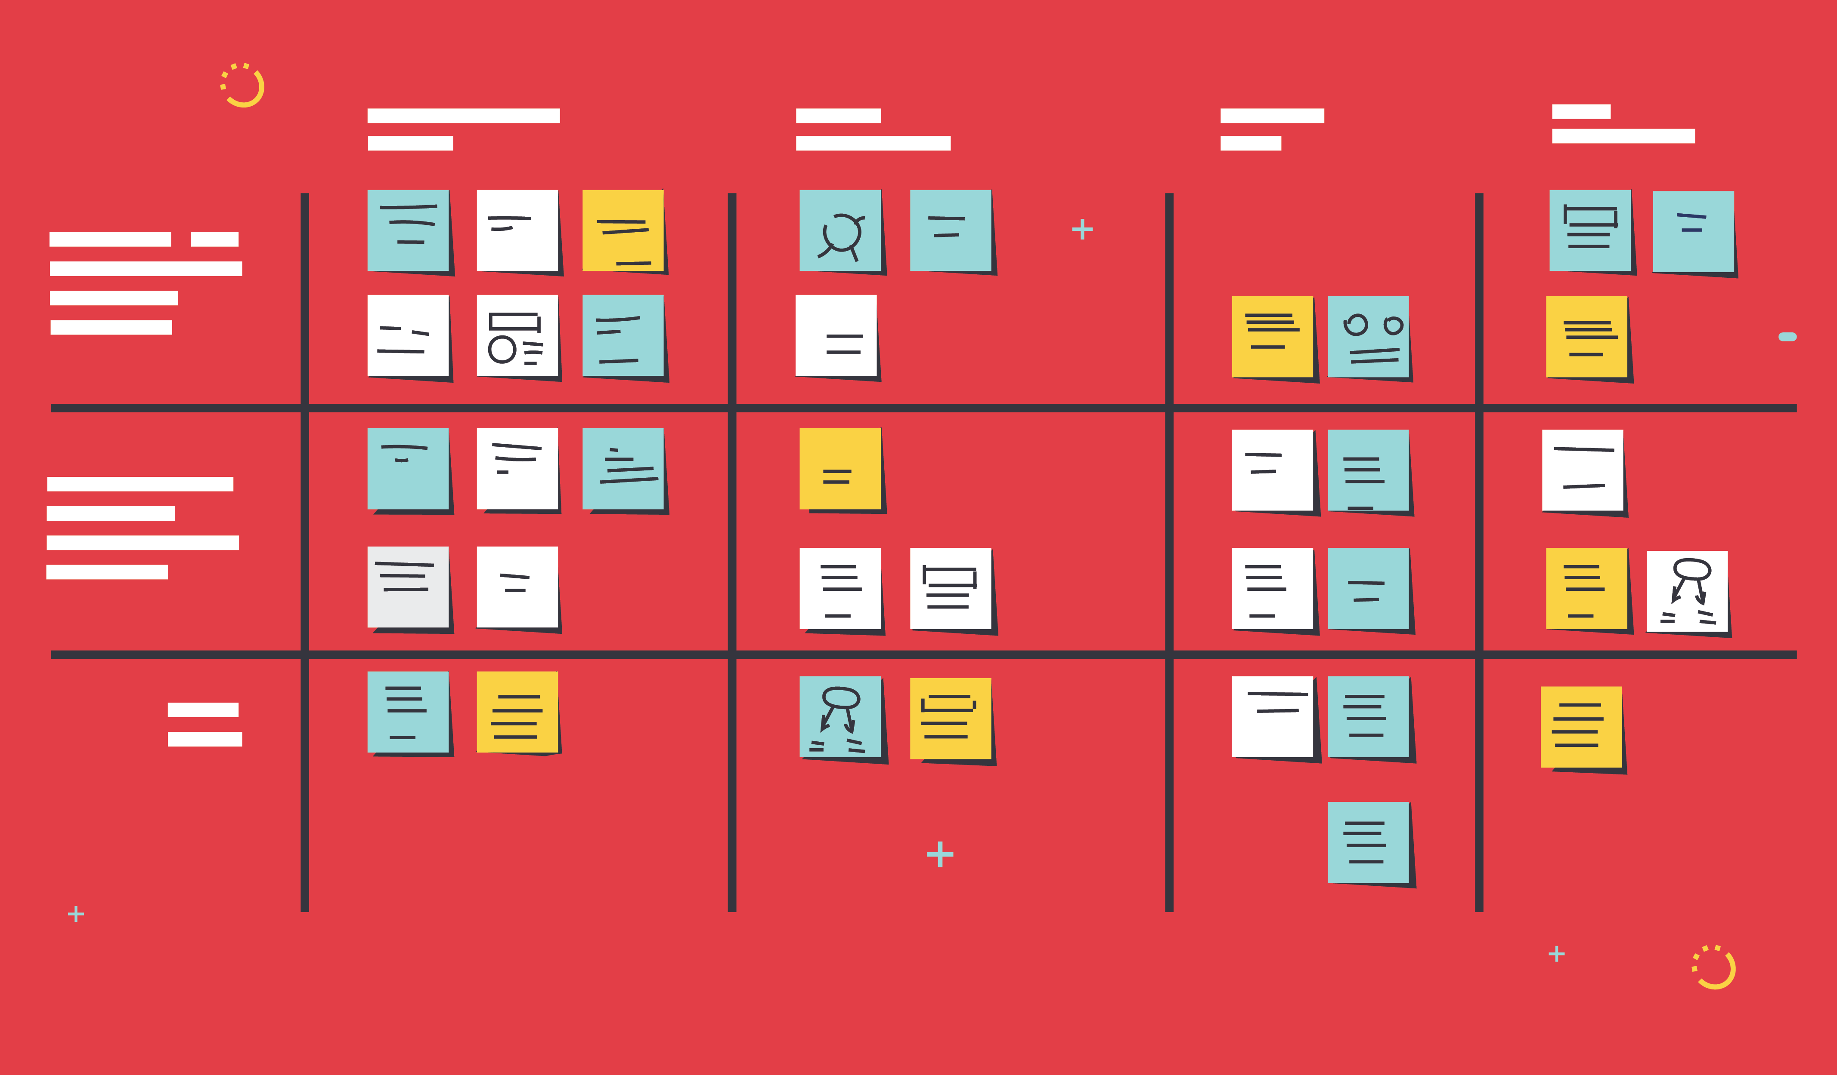


Break down the work into smaller pieces.

Slide 8
To conceptualize the displays you need,
start with a user story.
As a __________,
I need ___________,
in order to ___________.
As a site manager across four sites, I need to know how many new participants my sites signed up for the program each month in order to identify performance issues.
Anita

Slide 9
For each new display,
start with a user story.
As a funder of science education, I need to understand the impact of Science Festivals compared to other activities in order to prioritize funding decisions.
Anita

Slide 10
Prepare data for visualization

Slide 11
80% of data analysis is spent on the process of cleaning and preparing the data.
Dasu and Johnson 2003
https://vita.had.co.nz/papers/tidy-data.pdf

Slide 12
More data.
Means more formats.
With more users.
And new opportunities.

Slide 13
Tidy datasets are
Easy to manipulate, model and visualize, and
Have a specific structure: each variable is a column, each observation is a row.
https://vita.had.co.nz/papers/tidy-data.pdf

Slide 14
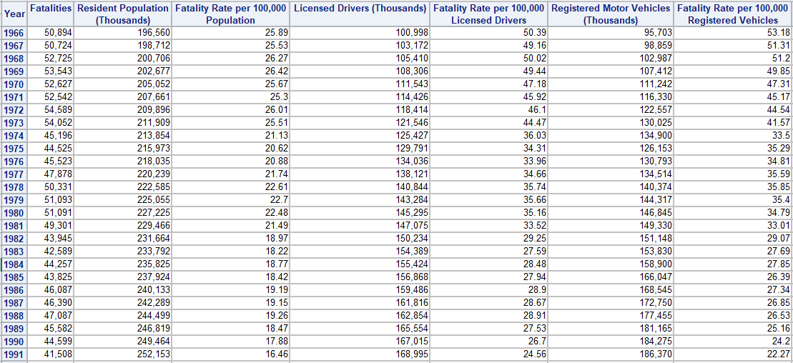
Tidy Data
For Pivot Tables, statistical analysis, and use with visual analytics tools

Slide 15
Explore
your data

Slide 16
If you don’t explore your data…
you don’t know where you’re starting, and you won’t know where you’re headed.

Slide 17
numerical exploratory data analysis
numbers from the sample that help guide the story
measures of center
measures of variation
frequencies
graphical exploratory data analysis
summary graphs that help guide the story
bar graphs
distribution displays
scatterplots

Slide 18
Design

Slide 19
Design choices
Keep it simple
Declutter
Purposeful use of color
Meaningful text
Consider the audience

Slide 20
Common mistakes
Overcrowding (white space is okay)
Lacks balance (text, figures)
No clear visual path

Slide 21
don’t forget
You are the critical link between the audience and
the data.

